Slide 1
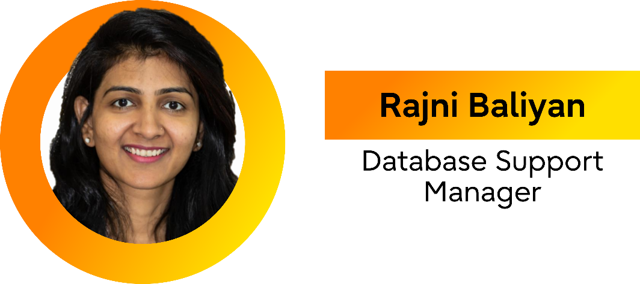
PostgreSQL support in the age of AI:
Don't forget the basics
FOSSASIA 2026
Notes:
Introduce the theme:
Good Afternoon everyone . My name is Rajni Baliyan and I am currently working with Fujitsu Australia since last 8+ years as an Operations Manager, focusing on leadership, strategy, and operational excellence.
Beyond my corporate responsibilities, I serve as President of PostgreSQL Down Under (PGDU) , an Australia New Zealand Postgres conference since 2019, where I actively promote PostgreSQL adoption, foster community collaboration, and lead knowledge-sharing . Also, I have presented my technical talks at global conferences in Australia and Singapore.
Today I will be talking about the support challenges we have when we are making Postgres a database of future with AI capabilities.

Slide 2
What does it mean?
Notes:
PostgreSQL has become the backbone of modern applications, especially in the AI era where new workloads bring unpredictable spikes, heavy read/write churn, and increasingly complex performance profiles. As PostgreSQL adoption grows, so does the responsibility place on support engineers. They’ve become the first responders, the ones keeping SLAs intact, revenue streams protected, and customer trust alive. But their job is getting harder.
You know, being a Postgres Support Engineer is a lot like being a firefighter...where they try to extinguish the fire , Except-
the building is made of data,
-the water is a specialized extension they need to compile themselves
and the person who started the fire is currently pinging and asking when will it resolve ?
Unfortunately, every time the water is different
In this talk we will see the real challenges of PostgreSQL support engineers in AI-driven environments and why fundamentals matter.

Slide 3

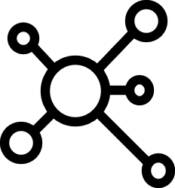



Why does support matter more than ever ?
The Postgres for everything era
The scale
explosion
The High Availability ceiling
Enterprise
continuity
The Swiss Army DB
From JSONB to pgvector
Mission-critical complexity
More power, more pressure
Scaling from GBs to multi-TB clusters
The Terabyte era
Managing massive replicas & write storms
99.99% uptime
No longer a goal, but a requirement
The MTTR race
Seconds equal revenue and customer trust
The anchor
Support is the constant amid vendor and cloud shifts
Reliability partner
Driving health through expertise, not just tools
Notes:
"So, why are we talking about this now?
What exactly has changed?
Why does the role of the support engineer matter more today than it did five or ten years ago?
Let’s drill down on each of these shifts."
We’ve entered the 'Postgres for Everything' era. Postgres has evolved massively over time, and back in 2023, it officially became the #1 database of choice in the Stack Overflow Developer Survey—a spot it’s held onto ever since. Because of this popularity, we aren't just storing simple rows and columns anymore. Postgres is now our document store, our time-series engine, and increasingly, the vector database powering our AI models. When Postgres is the heartbeat of your entire infrastructure, the support team isn't just 'fixing a database'—they are keeping the entire company’s brain alive.“
"Then there is the Scale Explosion. We’ve moved past the days when a 500GB database was considered 'large.' In 2026, multi-terabyte clusters are the standard, and we are managing them with hundreds of replicas and high-concurrency 'write storms. Now engineers are dealing with multi-terabyte clusters and high-concurrency workloads. At this size, there is no such thing as a 'small' problem; every bottleneck is amplified.
tolerance for downtime has hit zero. Business tolerance for downtime has basically hit zero. In 2026, the 'maintenance window' is a relic of the past; 99.99% uptime is now the bare minimum. This makes Mean Time to Recovery (MTTR) a survival metric that leadership tracks in real-time. When the database is down, every second your support team spends hunting for the right tool or digging through fragmented logs isn't just a technical delay—it’s a direct hit to the company's revenue.“
here’s a growing Complexity Gap. As a community, we’ve done an amazing job adding 'smart' features and AI-driven optimizations. But every new feature is another thing that can break in a unique way. We’ve made the database smarter, but we haven’t necessarily made it easier to troubleshoot.

Slide 4


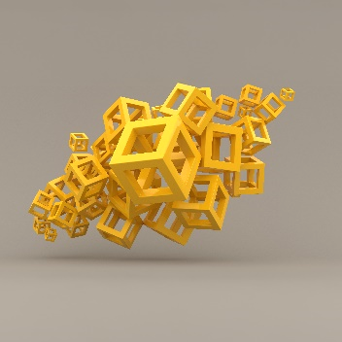


Some very common production issues and their operational impact
Performance bottlenecks
Core team
structure
Backup and
restore risks
Disk and memory issues
Performance friction: Locks, Latency, and Slow SQL
User impact: Degraded responsiveness in critical environments
Replication lag, slot mismanagement, and failover failures threaten data freshness and availability
Missing WAL segments and corrupted backups increase recovery time and risk data loss
Filesystem growth, out-of-space errors, and memory crashes require urgent troubleshooting to prevent failures
Notes:
PostgreSQL production environments commonly experience categories of incidents that place high cognitive and technical demands on support teams.
Performance bottlenecks often represent the most visible and urgent class of problems, where slow-running queries, lock contention, bloated tables, or I/O latency degrade application responsiveness.
Engineers must identify whether degradation originates from inefficient query plans, background processes such as vacuuming, or external factors like disk saturation.
Replication-related issues, including replication lag, slot mismanagement, or cascading failures during failover events, frequently threaten data freshness and high availability. Support teams must correlate replication metrics, WAL (Write-Ahead Log) behavior, and network throughput in real time to prevent data divergence or service interruption. Backup and restore failures produce equally critical risks: missing WAL segments, misconfigured archiving, or corrupted base backups may leave organizations with compromised recovery point objectives (RPOs) or increased recovery time objectives (RTOs). Additional categories include disk-related limitations—such as unexpected filesystem growth, out-of-space interruptions, or checkpoint pressure—and memory or crash scenarios where out-of-memory events, corrupted indexes, or abrupt restarts require immediate troubleshooting to avoid cascading issues. Across each domain, engineers rely on a constellation of tools and signals to isolate root causes, yet the fragmentation of these insights often delays resolution. Because each domain demands specialized knowledge and workflows, recognizing the breadth and complexity of typical incidents highlights why improving baseline troubleshooting experiences—before layering AI-assisted analysis—is essential for maintaining PostgreSQL resilience at scale.

Slide 5

Troubleshooting tools and the problem of tool sprawl

Slide 6







A few everyday support tools
 | Performance & query analysis | pg_top pg_stat_statements, pg_stat_activity, pg_stat_user_tables, pg_locks EXPLAIN ANALYZE pganalyze …
 | High Availability & replication | Physical: pg_stat_replication, pg_stat_wal_receiver pg_replication_slots Logical: pg_stat_subscription, pg_replication_origin, pg_publication Cluster: repmgr, Patroni
 | Backup & recovery | pg_backrest Barman pg_dump/restore WAL archiving logs
 | System & OS vitals | dmesg (OOM killer) iostat htop/top df –h free –m …
 | Monitoring & alerting | Prometheus Grafana Zabbix …
Notes:
When a performance issue hits, the 'why' could be anything. It might be a lack of computational resources, table locks, or simply too much data for the current config. It could be the silent performance killers like bloated tables or fragmented indexes.
The catch is that each of these problems has a different root cause, a different resolution, and—crucially—a different way to diagnose it. For some issues, you live in pg_stat_statements or EXPLAIN ANALYZE, hunting for that one 'rogue query' eating the CPU. But if the problem is a slow replica, you have to pivot completely. Now you're checking repmgr or querying pg_stat_replication and pg_stat_subscription to see where the lag is coming from.
If the database crashes, the Postgres-specific tools might not even tell you why. You have to jump into the OS layer. You’re checking dmesg to see if the OUT OF MEMORY (OOM) killer just executed a backend process, or running iostat because you suspect the underlying disk is hitting a latency wall.
And we haven't even touched the 'Safety Net' yet. When a recovery is needed, you’re deep in the configs of pg_backrest or Barman, praying that the WAL segments are exactly where they should be.
Every single one of these tools is excellent. They are powerful and reliable. But they all speak different languages, they all have different interfaces, and they all live in different tabs. In the heat of an outage, the engineer is the 'human integration layer’ , manually stitching all this data together in their head while the clock is ticking."

Slide 7
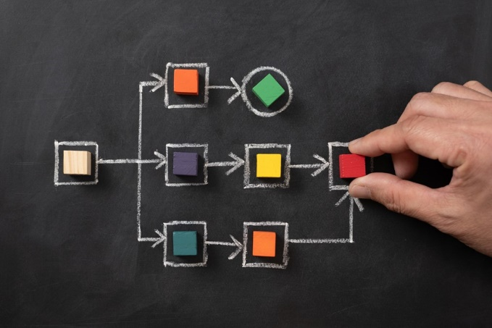
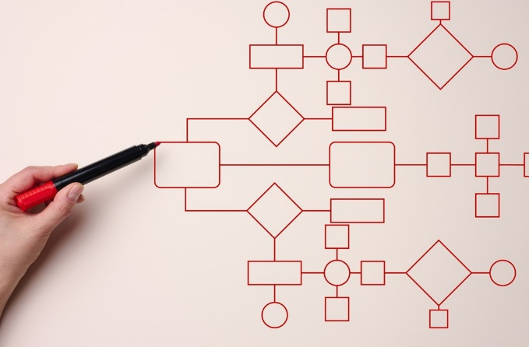
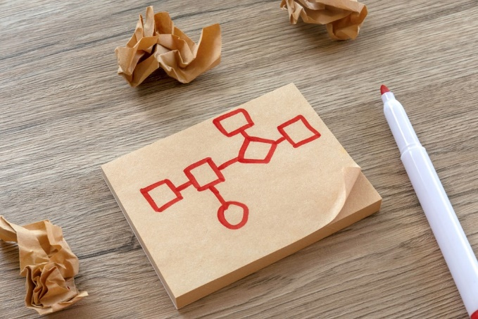

Operational pain points
Fragmented tool ecosystem
PostgreSQL support involves many isolated tools, forcing engineers to switch contexts frequently
Manual data correlation
Engineers manually correlate diverse data formats from PostgreSQL, OS utilities, and monitoring platforms
Operational challenges
Fragmentation causes slower decision-making, steep learning curves, and higher operational stress
Need for unified experience
A unified troubleshooting system can organize insights without replacing existing tools
Notes:
"We’ve looked at the tools, now let’s talk about the friction. When we say it’s hard to be a support engineer, these are the four specific 'walls' we hit every single day.
First, there is the Fragmented Tool Ecosystem. PostgreSQL support isn't a single workflow; it’s a dozen isolated islands. Every time an engineer has to jump from a SQL prompt to a Grafana dashboard, and then to a Linux terminal, they pay a 'context-switching tax.' It breaks their focus and burns mental energy that should be spent solving the actual problem.
Second is Manual Data Correlation. This is the most exhausting part of the job. You have a timestamp from a PostgreSQL log, a PID from a system utility, and a metric spike from a monitoring platform. None of them talk to each other. The engineer has to be the 'human bridge,' manually stitching these different formats together in their head just to prove they’re looking at the same event.
This leads directly to our Operational Challenges. Because everything is fragmented, decision-making is naturally slower. It also creates a massive 'learning wall' for new engineers. You don’t just have to learn Postgres; you have to learn the 'tribal knowledge' of how to navigate ten different tools. That results in higher operational stress and, ultimately, burnout.
Finally, we have to admit there is a desperate Need for a Unified Experience. To be clear: this isn't about replacing the tools we love. pg_backrest and EXPLAIN are world-class. This is about building a 'Command Center' that organizes those insights in one place. We need a way to see the 'big picture' without the friction of a thousand tabs."

Slide 8

The progress paradox

Slide 9






PostgreSQL is getting smarter… but not easier
The innovation boom
Postgres has evolved into a powerhouse for AI (pgvector)
and autonomous performance
The smart complexity
Every automated feature adds a new layer of internal
logic that needs to be monitored and debugged
New capabilities, new insights
These smart features give us more data and
more power than ever before
The missing
link
While the database is getting brains,
the troubleshooting experience is still stuck in past
The
paradox
We have AI to write the queries, but we’re still using
fragmented manual logs to figure out why they failed
Notes:
"When I say we need an IDE for troubleshooting, I’m talking about how we evolved as developers.
Think back to how we used to write code: you had a text editor, a separate terminal to run your compiler, and a completely different tool for your debugger. If you found a bug, you had to manually find that line of code in your editor. It was a lot of 'mental context-switching.’
Then came the IDE. It unified those steps. It understood that the code, the compiler, and the debugger were all part of the same story.
Postgres troubleshooting hasn't had its 'IDE moment' yet. Right now, we are still 'manually compiling' our understanding of an outage. We see a spike in a dashboard, we manually copy a query ID, we log into a terminal to run EXPLAIN, and then we jump to dmesg to check the kernel. We are the ones 'linking' the data.
When we talk about a Unified Experience, we are talking about bringing that IDE-level of integration to database operations. We want an environment where the metrics, the logs, and the database views 'know' about each other—so you can spend your time fixing the problem instead of just trying to find it."

Slide 10


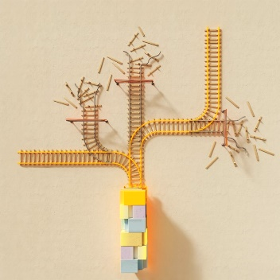


The path forward:
A unified open-source future
Bridge
the gap
Stop the
manual shuffle
Keep it
open
The
goal
Move from fragmented tools to an IDE-like experience for database operations as well
Let the tools handle the correlation so engineers can focus on the resolution
Ensure that the Command Center for the world’s most advanced database stays as open and accessible as the engine itself
A 2026
troubleshooting experience for
a 2026 database
Notes:
"So, where do we go from here?
The path forward is clear: we need to Bridge the Gap. We’ve spent decades perfecting the database engine; now we need to perfect the experience of running it. We need to move past the era of 'The Manual Shuffle' and build an environment where our tools finally speak the same language.
Imagine a world where you aren't the 'human integration layer'—where you don't have to carry context in your head between five different tabs. Instead, you have a Unified Cockpit that allows you to see the problem, correlate the data, and take action in one fluid motion.
But most importantly, we need to keep this Open. The best troubleshooting insights shouldn't be locked behind a commercial paywall or a 'walled garden.' The community that built the world’s most advanced database deserves a world-class, open-source way to manage it.
We have the smartest engine. Now, let’s build the smartest cockpit. Let’s make PostgreSQL as easy to support as it is to love.

Slide 11




Why this matters
Reduce stress for support teams
Faster root
cause analysis
Improve
customer trust
Retain Postgres as preferred platform for organizations
Notes:
"At this point, you might ask: 'We’ve survived this long with fragmented tools, so why does a unified experience matter now?’

Slide 12

The roadmap to a unified future
Notes:
What an Integrated Troubleshooting Hub Could Look Like

Slide 13
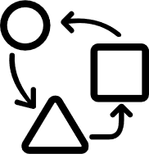




Bridging the gap between observation and action
Define
open standards
Encourage plugin interoperability
Adopt an
IDE mindset
Join the movement
Establish a common data schema for how open-source Postgres tools share metrics and events
Build bridges between existing giants like pg_backrest, Patroni, and pg_stat_statements
Focus on the user experience of troubleshooting, not just the raw collection of data
Contribute to the open-source efforts aimed at building the first Unified Cockpit for PostgreSQL
Notes:
"So, how do we get there? We’ve seen the gap, and we’ve seen the vision. Now, we need a roadmap. "So, what are we proposing? Not just another dashboard, but a Unified Open Source Cockpit.
First, we have to Define Open Standards. For our tools to talk to each other, they need a common language. We need to agree on how we share metrics and events so that any tool in the ecosystem can plug into our 'Unified Cockpit' seamlessly.
Second, we need to Encourage Interoperability. We don’t need to reinvent the wheel. We already have incredible tools like pg_backrest for recovery and Patroni for high availability. Our goal should be to build the 'connective tissue' that allows these tools to share context with one another.
Third, we must Adopt an IDE Mindset. As a community, let’s stop just asking 'What data can we collect?' and start asking 'How can we make this data more actionable?' We need to design for the engineer in the middle of a 3 AM outage, making their workflow as intuitive as a modern code editor.
Finally, Join the Movement. This isn’t a project for one company; it’s a mission for the entire Postgres community. Whether you are a developer, a DBA, or a support engineer, your perspective is what will build this.
We’ve made Postgres the most advanced 'brain' in the database world. Now, let’s give it the open-source cockpit it deserves. Let’s build the future of troubleshooting, together.
Thank you!"

Slide 14
Some thoughts
  A unified, extensible troubleshooting platform that consolidates observability, diagnostics, and runbooks into a single pane—purpose-built for PostgreSQL support
  Core goals
Single source
of truth
for queries, logs, replication,
and resource metrics
Faster
RCA
(root cause analysis) with guided workflows and correlated views
Standardized playbooks
so support engineers follow the same steps and generate consistent outcomes
Pluggable
across on-prem, cloud, and managed PostgreSQL distributions

Slide 15
Thank you

