Slide 1

Developing PostgreSQL extensions in C: Hooks, shared memory & best practices

Slide 2






What is Postgres Extension
A self-contained package of SQL definitions, optionally backed by native code (C/Rust) or other supported languages
Loaded dynamically into the PostgreSQL server
Adds new capabilities without modifying core source code
Executes inside the database engine
Think of it as an App on top of Android/iOS that adds powerful new features

Slide 3








Why are extensions needed?
 | PostgreSQL core must remain stable, generic, and lightweight
 | Not all features can be included in the core database
 | Different applications require different capabilities
 | Extensions allow optional, plug-in functionality
 | Enable faster innovation outside core release cycles
 | Let users install only what they need
Examples of popular PostgreSQL extensions
pgvector Vector / embedding data type support for AI & similarity search
PostGIS Spatial & geometric data store (GIS support)
hstore Key–value (column-like) data storage
pg_stat_statements Statement-level execution statistics
Extensions make PostgreSQL flexible, powerful, and adaptable—without compromising core stability

Slide 4



Architecture of PostgreSQL
Background writer
Client
Postmaster
(Postgres server process)
checkpointer
Autovacuum
Backend process
WAL writer
Logging collector
Parser
Shared buffer pool
WAL buffers
Commit log (pg_xact_SLRU)
Analyzer
Rewriter
Planner
page 0
Data files
WAL segment files
pg_xact files
page 1
Executor
page 2

Slide 5




Where extensions can be implemented
Backend process (native logic)
Query pipeline (execution hooks)
Shared memory (global brain)
Background workers (automation)
Extensions load dynamically here to execute custom C/Rust functions for a specific user session
Placed near the Parser/Planner/Executor- this allows code to intercept and change how queries are processed
Located in the Shared Buffer/WAL area - this allows your extension to store data that all users can see
Placed near the Background Writer - these are autonomous processes that run without a client being logged in

Slide 6





C-extension code structure
vacuum_booster
vacuum_booster.control
(the ID card)
vacuum_booster--1.0.sql
(the bridge)
vacuum_booster.c
(the engine)
Makefile
(the instructions)

Slide 7

Activating the extension
STEP 1
Physical installation
The C code is compiled into a shared library (.so or .dll) and placed in the PostgreSQL /lib directory
The .control and .sql files are moved to the /extension directory
STEP 2
Server-level loading (the pre-load)
Add the extension name to shared_preload_libraries in postgresql.conf
During startup, Postgres calls _PG_init(), which attaches the eyes (hooks) and reserves the brain (shared memory)
STEP 3
SQL registration (the bridge)
User executes CREATE EXTENSION vacuum_booster in the SQL console
Postgres runs the SQL script to register the C functions so they can be called by users

Slide 8


Challenge: High-velocity bloat management
The limitation of generic thresholds
The information latency gap
PostgreSQL core is designed to be stable and lightweight for all users
Standard cleanup typically triggers at fixed percentages (e.g., 20%)
The edge case: On a 500GB table, 100GB of dead junk accumulates before a worker wakes up - we are reacting to the fire, not preventing it
The shared-memory stats (PG 15+) are an excellent Accounting System
However, they are not an Alerting System
The need: High-velocity workloads require an immediate event trigger that the standard polling loop isn't designed to provide

Slide 9



Hardware alignment — Execution & resource utilization
Hardware underutilization in modern cloud (64+ Cores / 256GB RAM / NVMe) | The cost_limit is a vital legacy brake designed to protect slow HDDs On modern NVMe storage, this can cause the janitor to spend 90% of the time sleeping while the disk sits idle Resource gap: On large cloud instances, the throttled Autovacuum cannot exploit available high-core counts and large RAM overhead to handle extreme bloat
The strategy: Extending, not modifying | Instead of changing core source code, we use Execution Hooks and Background Workers. This fills the performance gap for specialized hardware without compromising the stability of the core engine.

Slide 10





Proposed solution: vacuum_booster
Event-driven detection
Shared memory scoreboard
Targeted cleaning crews
Complementary design
Using Executor Hooks to detect dead tuples the millisecond a query finishes
Ensuring the entire cluster has real-time awareness of which tables are hot
Launching Dynamic Background Workers to start cleaning immediately, bypassing the naptime for mission-critical tables
This works alongside standard Autovacuum, offloading high-pressure tasks to specialised workers

Slide 11

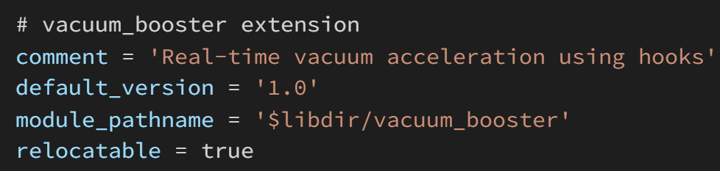
The ID card ● vacuum_booster.control

Slide 12
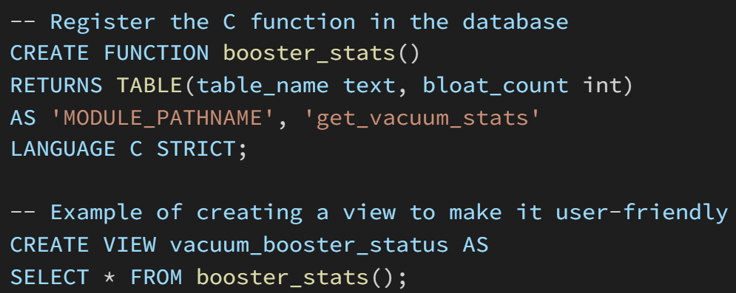
The SQL bridge ● vacuum_booster--1.0.sql

Slide 13

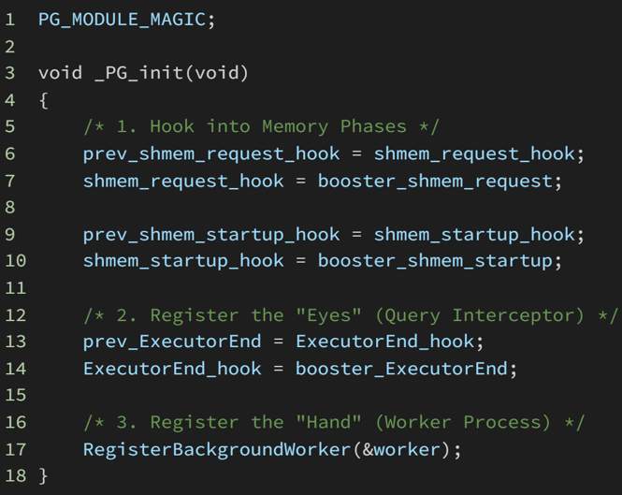
Extension entry point ● vacuum_booster.c

Slide 14

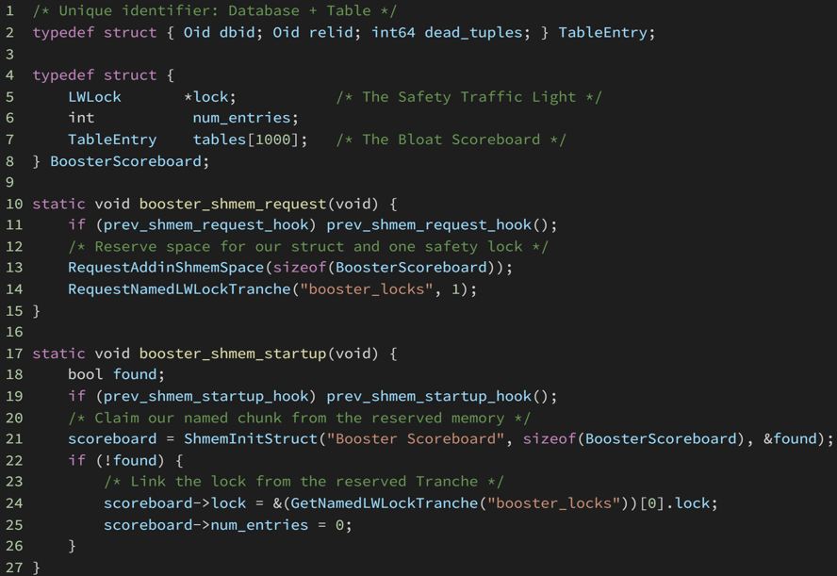
The global brain ● Definition & Allocation

Slide 15

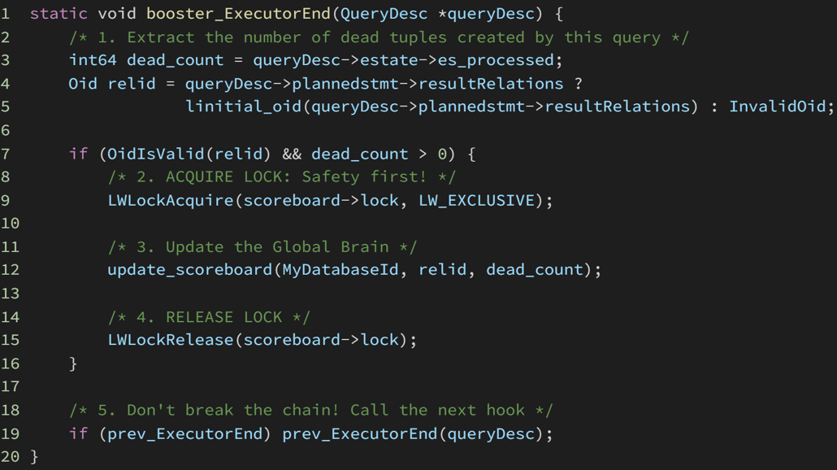
The eyes ● The Executor Hook

Slide 16
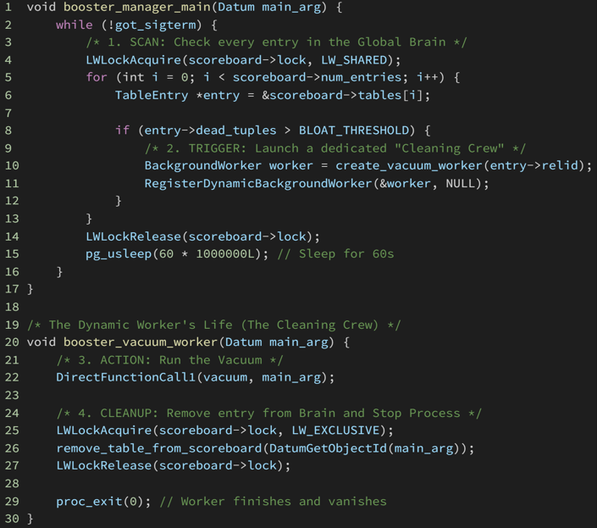
The manager & the dynamic lifecycle

Slide 17


The proactive vacuum ecosystem
 | Component | The role | The action
 | The eyes Executor hook | Query Interceptor | Detects dead tuples immediately after a query finishes and writes the score to the Brain
 | The brain Shared memory | Global Scoreboard | A central, locked array storing dbid, relid, and bloat_count for the entire instance
 | The manager BG worker | The Supervisor | Scans the brain in a regular period; if a table is too dirty, it launches a specialized Cleaning Crew
 | The hand Dynamic worker | The Cleaning Crew | Connects to the database, runs the VACUUM, and deletes the entry from the Brain upon completion

Slide 18



Best practices for C-extension development
Be a good citizen
Process integrity
Safe memory
Maintain the hook chain
Postmaster supervision
Proper reservation
Always save prev_hook and call it after your logic
Ensures compatibility with other extensions like pg_stat_statements
Register all workers (static or dynamic) with the Postmaster
Never fork() manually - let the engine manage process lifecycles
Request Shared Memory and LWLocks during _PG_init via official hooks
Use named LWLocks to prevent collisions and improve debuggability

Slide 19


Best practices for C-extension development
Defensive engineering
Error context & logging
Validate all OIDs and pointers before execution
Ensure workers are signal-aware for graceful shutdowns
Use the standard PostgreSQL ereport() or elog() macros with appropriate levels (DEBUG, LOG, ERROR).
The practice: Provide clear context in logs so administrators can distinguish between a standard Autovacuum action and a vacuum_booster action

Slide 20
Q&A

