Slide 1
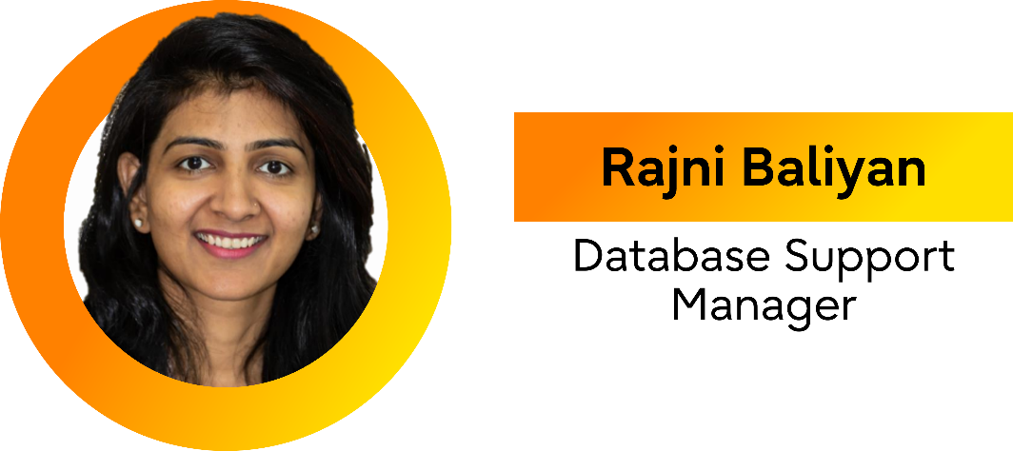
Community at the core, enterprise at scale
How does PostgreSQL thrive through collaboration?
FOSSASIA 2026
Notes:
Good Afternoon everyone . My name is Rajni Baliyan and I am currently working with Fujitsu Australia since last 8+ years as an Operations Manager, focusing on leadership, strategy, and operational excellence.
Beyond my corporate responsibilities, I serve as President of PostgreSQL Down Under (PGDU) , an Australia New Zeland Postgres conference since 2019, where I actively promote PostgreSQL adoption, foster community collaboration, and lead knowledge-sharing . Also, I have presented my technical talks at global conferences in Australia and Singapore.
This is my first time presenting in the FOSASSIA and look forward to this great journey together.

Slide 2
What does it mean?
Upstream PostgreSQL community at the core wrapped in an enterprise layer for repeatable operations at scale
Notes:
Community at the Core, Enterprise at Scale is a philosophy of how PostgreSQL thrives.”
"When we say 'Community at the Core,' we’re talking about the soul of the database. This is the upstream code—unbiased, independent, and architecturally pure. It’s the reason we trust Postgres; it belongs to everyone and is beholden to no single vendor."
This represents the pure upstream open‑source engine—the part developed, reviewed, and maintained by the global PostgreSQL community.” “This is the heart of everything.
No forks.
No proprietary deviations.
Just the open‑source core that gives PostgreSQL its reliability, stability, and innovation.”
The idea is that the community provides the foundation, while enterprises extend it safely and consistently.”

Slide 3






Postgres history
From research project to enterprise backbone
1975-1977
Early 1980s
1986
1994
1996
Today
Ingres built
at UC Berkeley
"Post-Ingres"
direction
POSTGRES
implemented
SQL added by
Yu & Chen
Renamed to
PostgreSQL
Simply called
Postgres
Notes:
“PostgreSQL has a long and rich history that traces back to University of California at Berkeley in 1970s.”
“The database we know today as PostgreSQL began as the POSTGRES project at Berkeley.
It evolved out of earlier research, and over several decades of continuous development, it has become one of the most advanced open‑source databases in the world.”
“A major milestone came in 1994, when Andrew Yu and Jolly Chen added SQL support to POSTGRES.
With this improvement, the system was released to the web under a new name — Postgres95.
That release marked the point where the project really began to take off as open source.”
“Then in 1996, the name changed again — this time to PostgreSQL — to reflect its full SQL capabilities.
But even today, many people still call it simply Postgres, partly out of tradition and partly because it’s easier to say.”
“So what we use today is the result of decades of research, community effort, and evolution — a modern, powerful database with deep academic roots and a strong open‑source identity.”

Slide 4
How Postgres evolved over the period
PostgreSQL is experiencing a massive surge in popularity, becoming the most loved, wanted, and frequently used open-source database among developers since 2023
6.0
9.6
10
11
12
-
1997-2016
2017
2018
2019
Streaming Replication
Synchronous Replication
Row-level security
Materialized views
json/jsonb data types
Foreign tables
Declarative Partitioning
Logical Replication
SQL stored procedures
Partitioning by hash key
pgvector, JIT support
Partitioning performance enhancements
Query JSON data support
15
14
13
2022
2021
2020
Row/column filtering
in Logical Replication
Merge command
Shared memory stats
Logical Replication for in-progress txns
Snapshot scalability (better reads)
Reduce bloat for B-tree index updates
Parallel foreign table scans via postgres_fdw
Parallelized vacuum
for indexes
De-duplication in B-tree index
Incremental sorting
16
17
18
2023
2024
2025
Logical replication from standby
Parallel apply of large txns
SQL/JSON standard compliance
Faster relation extension
Load balancing via libpq
Failover slots
Incremental backups
Remove 1GB limit
for vacuum cleanup
SQL/JSON standard
JSON_TABLE
Various improvements in Logical Replication
Enhance table AM APIs for different storage engines
Import/export statistics
Asynchronous I/O
Notes:
Postgres evolve over the period and in 2023 it because database of developer choice positioning at #1 in the Stack Overflow Developer Survey This timeline shows how Postgres evolve and with a consistent major version release and each release

Slide 5

Commercial contributions

Slide 6













How do commercial organizations contribute?
 | Direct funding | Sponsoring contributors, events, infrastructure, and community programs
 | Scale validation | Testing on large datasets, diverse platforms, and production-like workloads
 | Engineering time | Feature development, bug fixes, reviews, and long-term maintenance
 | Ecosystem tooling | Backups, HA, monitoring, security, migration tooling—often open sourced
 | Support , Advocacy & adoption | Training, best practices, and helping organizations choose PostgreSQL , provide 24x7 professional support
Funding
Scale validation
Support
Engineers
Advocacy & adoption
Ecosystem tooling
Review & consensus
Openness
Long-term trust
Shared learning
Bug fixes, new features
Wider platform support
Notes:
"There is a persistent myth that the 'Community' and 'Enterprise' exist in two different worlds—one driven by passion and the other by profit. In the PostgreSQL ecosystem, we’ve proven the opposite: they are two halves of the same heart. This isn't a story of 'us versus them'; it is a story of radical collaboration. The community provides the neutral ground and the architectural vision, while organizations provide the professional velocity and real-world stress testing. We don't just coexist; we collaborate to build something neither could achieve alone.“
"But what does this friendship look like in practice?
=====
It starts with something simple: funding.
Think of it as fueling the engine—companies contribute money that keeps conferences running like we have our FOSSASIA sponsors – AWS , Fujitsu etc. , keeping infrastructure alive, and community programs thriving.
"When we talk about 'Funding,' it’s easy to look at it through the lens of a traditional marketing budget. But some of the most important investments in Postgres aren't about ROI (Return on Investment) —they are about responsibility."
Let me just share my Personal story on funding
"Early in my Postgres journey, I asked my Marketing Manager a very blunt question: 'Why are we spending money to sponsor these events if we aren't gaining new customers directly from them?' His answer stayed with me. He said:
'We don’t sponsor these events to find customers—we have a sales team for that. We sponsor to pay our gratitude, and to fulfill our responsibility to the project’s stability as this is our responsibility. This was a lightbulb moment for me and that day I truly understood the concept of sponsorship.
But the real magic happens when they contribute people.
Enterprises lend their engineers—smart, passionate folks who write features, fix bugs, review patches, and keep PostgreSQL rock‑solid year after year. Many enterprises has dedicated OSS team who purely work on opensource code -they bring real‑world problems from real‑world systems, and that shapes the database in ways no lab ever could.
"Then we have Ecosystem Tooling. This is where the partnership gets practical. Enterprises often build high-performance tools for themselves—extensions for AI, high availability, or monitoring—and then give them back to the community
"Finally, there is Support and Advocacy. By providing 24/7 professional support and clear best practices, enterprises provide the 'safety net.' They reduce the fear of the unknown, making Postgres the 'Developer’s Choice' by proving it is ready for the world’s most mission-critical workloads."

Slide 7

Community governance
Notes:
"PostgreSQL is designed to be permanent. While other projects are built to be eventually sold or 'monetized,' Postgres was built to endure. It is a community-owned utility that cannot be bought. It’s not just a database; it’s a masterclass in how to build a project that no single company can ever own, sell, or kill. With Postgres, users can truly trust the long-term independence of the tools they build on.“
"Independence is a feature, not an accident. It is enforced by a system of structural locks that prevent any single entity from gaining control. I want to walk you through the five key mechanisms that protect Postgres’s status as a truly community-led, 'uncorruptible' project:"

Slide 8





Why does PostgreSQL stay independent ?
No single vendor
rule
No one company owns the trademark, domain, or code
Core team
structure
A diverse, merit-based leadership body
Legal
protection
Neutral non-profits (PGCU, PEU) manage assets
License
factor
The permissive PostgreSQL license prevents open-core traps
Sustainable
contribution
Development is funded by a competitive ecosystem of vendors
Notes:
----
No vendor lock in : "Unlike other commercial DB products , PostgreSQL is not owned by any single corporation. This is its greatest superpower. It ensures that the roadmap is driven by technical excellence and user needs rather than by a single company’s business decisions.
Core Team : Membership is based on decades of proven merit and 'acting for the good of the project.' This prevents any one corporate entity from 'buying' a majority seat at the table.“
Legal Protection : PGCU ,PEU are non for profit organizations manages assets and project independence to protect the projects neutrality . We have a very classic exampke of MySQL – which was open sourced in early 2000s but owned by one company and held the trademark and copyrights and they could and did sell the whole project . Postgres is one of the rare Opensource projects which is still open source even after decayed.
License factor : , it ensures that the best version of the software is always the one available to the community
Sustainable contribution : "Finally, independence creates a healthy, competitive ecosystem. Because no one owns Postgres, many companies (like EDB, Microsoft, AWS, and Crunchy Data) feel safe investing in it.

Slide 9

Challenges at enterprise scale and solutions
Notes:
"We’ve established that Postgres is a masterclass in governance, but as any SRE will tell you, a 'perfect' database isn't much help if it's hard to manage at 3:00 AM. When you scale Postgres across thousands of nodes in a global enterprise, the challenges shift from 'Does the database work?' to 'Can we operate this reliably and predictably?' This is where the theoretical meets the practical.“ and enterprise organizations plays a vital role.
"While the core engine is rock solid, the ecosystem around it still presents significant hurdles for large-scale adopters. These aren't necessarily 'bugs' in the code, but rather 'frictions' in the operational lifecycle. Let’s look at where these enterprise pain points are most acute—and why these are exactly the areas where our community collaboration is focused today and the main reason that Postgres is a trusted DB for most organizations today.

Slide 10



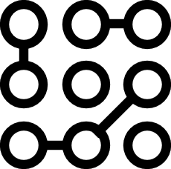

Bridging the gap:
Solving enterprise operational friction
Operational
support gaps
Observability
fragmentation
Complexity
at scale
Risk
management
Runbooks vary widely; troubleshooting often depends on tribal knowledge
Many great tools, but inconsistent formats and poor correlation across layers
HA topologies, multi-region latency, storage behaviors, noisy neighbors
Upgrades, major-version planning, security patching, compliance evidence
Notes:
Operational Support Gaps
"Because Postgres is so flexible, every company builds their own 'special sauce' for management. The result? Runbooks are inconsistent across the industry. We still rely too much on 'tribal knowledge'—that one senior DBA who just knows what’s wrong. The community is working to bridge this through better standardized automation and shared Best Practices.“
Observability Fragmentation
"We have a wealth of tools—pg_stat_statements, Prometheus exporters, and various log analyzers. The problem isn't a lack of data; it's that the data doesn't always talk to each other. Correlating a spike in disk I/O with a specific SQL query across different layers is still harder than it should be.“
Complexity at Scale
"Scaling isn't just about adding more RAM. It’s about High Availability (HA) topologies that don't flap, managing latency in multi-region setups, and dealing with 'noisy neighbors' in shared environments. These behaviors—especially regarding storage and vacuuming—become non-linear and unpredictable at high volumes.“
Risk Management
"In an enterprise, 'moving fast' is secondary to 'not breaking things.' Planning for a major-version upgrade or gathering evidence for a SOC2 compliance audit can take months. The community helps here by providing long-term support cycles and more transparent security patching processes to de-risk the platform."
I will be focusing more on these Operation challenges in my PGDay session as well, so if you want to know more about it then join me on PGDay

Slide 11
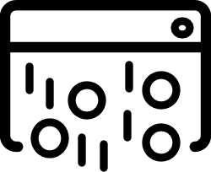
Behind the code
Notes:
"Code doesn't maintain itself; people do. If the code disappeared, our community could rebuild it—but without the community, the code stands still. The health of Postgres is found in its people, not just its repository.“
"It takes a global village to keep this engine running. Let’s look at the specific human roles that ensure Postgres remains stable, secure, and independent:"

Slide 12
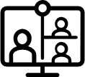




Behind the code:
Roles that keep Postgres healthy
Committers
Apply patches and steward quality
Maintain project standards
Guide release readiness
Contributors
Submit patches, docs, and tests
Improve translations and tooling
Triage issues and reproduce bugs
Reviewers
Provide code/design feedback
Performance & security scrutiny
Ensure architectural coherence
Release & Infrastructure
Builds, CI, packaging, mirrors
Security response coordination
Release process and documentation
Notes:
Key message: Make the invisible wo
The Core Team
“As we already learnt about the Core team, they protect the project’s neutrality. Their primary job is to maintain the reputation of Postgres and ensure it remains independent of any single corporate interest.“
Committers
"Committers are the ultimate gatekeepers. They have 'commit bit' access, meaning they are responsible for the final quality of the code. They spend far more time reading and refactoring patches than writing them, ensuring that every addition meets our 'gold standard' for stability.“
Contributors
"This is the lifeblood of the project. Contributions aren't just code—they are documentation, bug reports, translations, and tests. Anyone in this room can be a contributor. It’s this massive, global input that keeps Postgres relevant across every language and industry.“
Reviewers
"In many ways, reviewers are the unsung heroes. They provide the 'peer review' that makes Postgres so secure. They scrutinize design logic and performance impact, ensuring that a new feature for one user doesn't accidentally slow down the database for everyone else.“
Release & Infra Teams
"These are the teams that run the 'Swiss Watch.' They manage the CI/CD pipelines, the global mirrors, and the packaging that allows you to apt-get install or yum install with confidence. They also coordinate the high-stakes security response when vulnerabilities are found."
"The common thread here is that most of these people are volunteers or supported by different, competing companies. They work together because they all benefit from a healthy, stable PostgreSQL."
rk visible. Reviews, docs, and tests are as critical as new features. Emphasize that companies often sponsor contributors and allow upstream time, which sustains the project.

Slide 13
Shaping tomorrow
Notes:
"Postgres has spent decades becoming the most trusted database in the world, but the next chapter is being written right now. The 'Tomorrow' of Postgres isn't being decided in a corporate boardroom; it is being shaped at the intersection of enterprise-scale pressure and community innovation. This partnership is what ensures Postgres doesn't just survive the next decade, but leads it."

Slide 14





Where does the partnership matter most?
Security & supply chain resilience
Modern infrastructure performance
Operational excellence
Developer experience
AI-adjacent
use cases
Faster response
Better tooling
Verified builds
Optimizing for next-gen hardware
Cloud-native environments
Sales upgrades
Deeper observability
Standardized runbooks
Streamlined migrations
Compatibility
Better ergonomics
Vector workloads
Retrieval-Augmented Generation (RAG)
Build on solid foundations
Notes:
Security & Supply-Chain Resilience
"In an era of increasing cyber threats, 'good enough' security isn't enough. Our partnership focuses on faster response times and 'hardened' supply chains—ensuring that every binary and package you install is verified, transparent, and resilient against modern threats."
Modern Infrastructure Performance
"We are moving beyond the limitations of legacy storage. The community is actively optimizing Postgres to squeeze every drop of performance out of modern NVMe drives, high-core-count processors, and the unique 'noisy neighbor' dynamics of the cloud."
Operational Excellence
"We want to take the 'fear' out of 3:00 AM operations. This means making major version upgrades a non-event, providing 'white-box' observability into the engine’s internals, and moving away from tribal knowledge toward clear, industry-standard runbooks."
Developer Experience
"The best database is the one that developers love to use. We are focusing on 'ergonomics'—making migrations smoother, improving compatibility with other systems, and building the tooling that makes the 'first mile' of development as fast as the 'last mile' of production."
AI-Adjacent Use Cases
"AI doesn't need a brand-new database; it needs a rock-solid one. By building vector search and smarter automation on top of Postgres’s 'solid basics,' we ensure that your AI workloads benefit from the same ACID compliance and reliability you’ve trusted for years."
By bringing enterprise challenges to the community and community innovation back to the enterprise, we ensure that Postgres remains the permanent foundation for the next generation of technology. The partnership we build today is what keeps Postgres independent, capable, and ahead of the curve."

Slide 15





How you can contribute (and benefit)
If you are
a user/operator
Share reproducible cases, improve runbooks,
contribute docs and monitoring patterns
If you are
a developer
Review patches, write tests, improve tooling interoperability, maintain extensions
If you are
from a company
Sponsor upstream work, allow contribution time,
support events/mentorship, upstream-first strategy
If you are
new
Start with docs, issue triage, reproductions, or small test improvements - high leverage
Join local Postgres user groups, participate in conferences
Notes:
You can be part of this journey in many ways whether you are user, a developer , company or new to this community . Each small step matters to keep up the spirit of Open source and help Postgres remain the choice of modern platforms.

Slide 16
Thank you

